Slide 1
Medical Chatbot- Project Progress
AI FOR HEALTHCARE ASSISTANCE
Presented by : Sneha Shekhar
229303423

Slide 2
Introduction
Objective : Develop an AI powered chatbot for medical queries.
Key Technologies:
HuggingFace embeddings
Faiss CPU (Vector storage)
Mistral + Streamlit (Chat Interface)
Current Progress: Implementing core functionalities using open-source frameworks

Slide 3
What are the key technologies?
HuggingFace Embeddings – A technique to convert text into numerical vectors (embeddings) using models from Hugging Face. These embeddings help the chatbot understand and compare the meaning of words or sentences.
Faiss CPU (Vector Storage) – A library developed by Facebook AI for efficient similarity search. It stores embeddings and quickly finds the most relevant match when a query is given. The CPU version is optimized for standard computing without requiring a GPU.
Mistral + Streamlit (Chat Interface) –
Mistral: A lightweight, high-performance AI model used for generating responses in the chatbot.
Streamlit: A Python-based web framework that helps create simple interactive user interfaces for AI applications, such as chatbots.

Slide 4
HuggingFace Embeddings
Converts text into numbers (vectors) so the chatbot can understand and compare different words/sentences.
Example: "headache" and "migraine" might have similar embeddings because they relate to the same medical topic.
Faiss CPU (Vector Storage)
A fast-search tool from Facebook AI that stores embeddings and finds the closest match when a user asks a question.
Works like a smart medical dictionary—instead of searching for exact words, it finds the most relevant information based on meaning

Slide 5
Project Architecture
Input : User medical queries
Processing:
Convert queries into embeddings (HuggingFace)
Search stored medical data (Faiss)
Generate responses using LLM (Mistral)
Output: AI-generated responses displayed via Streamlit

Slide 6
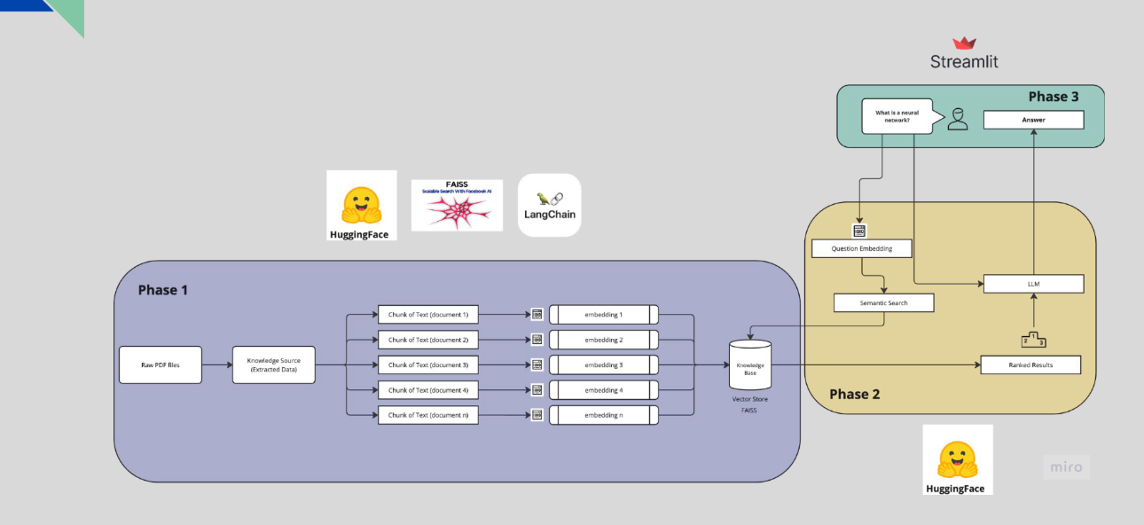

Slide 7
Research Insights
How the Chatbot Works:
Converts medical queries into embeddings (HuggingFace)
Searches stored knowledge base using Faiss
Generates responses via Mistral
Strengths:
Efficient similarity search
Lightweight chatbot framework
Limitations:
Requires high-quality training data
Might struggle with complex medical queries

Slide 8
Next Steps
Frontend Development:
Design user-friendly interface using React/Vite
Implement chatbot UI for seamless interaction
Backend Integration:
Connect frontend with model backend
Optimize API calls for efficient data retrieval

Slide 9
Conclusion & Q&A
Summary:
Researching AI chatbots for medical applications
Initiating frontend and backend integration
Planning improvements for better performance
Open for Questions

